Slide 1
Python programming
unit 3a - function

Slide 2
Create your own functions
Functions are a block of code to perform some specific tasks or finish some specific jobs.
When you want perform that job just call / invoke the function.
Create functions can allow to use this them in different places when you need them. This way can reduce the total code quantity, also make it easy to maintain if you want change it later. (only one place to make the modification and the place where you want use it keeps same.)

Slide 3
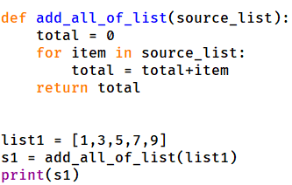
Create your own functions
Followed by function name (an identifier)
Argument list inside round bracket
Def is the keyword to start create a function
Code block to do the function specific job
Return goes back to where the function was called.
If return has a variable follows, then the value of that variable will send back to the function caller
The value returned will be kept using a variable
Calls to a function using the name
The value is passed to the arguments and inside the function can use it

Slide 4
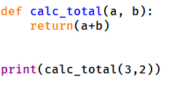

One more example
This example defines a function named calc_total.
It takes two arguments, a and b.
It returns one value, which is the sum of the two arguments’ value.
The function was called and the return value was given to build-in function print.
You can use it whenever you want do similar job at other place of your code.

Slide 5
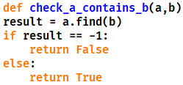
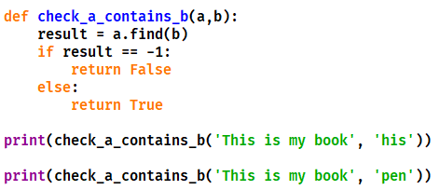
In class practice: what is the result for those code?

Slide 6
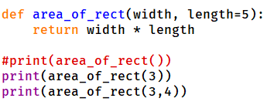
Default value for arguments
Arguments can have default value. If did not specify the value when call the function, it will take the default value. If specified, then it will take the value that is specified.
Arguments which have default value must be positioned after those do not have default value.
When calling a function, should at least give value for those arguments who do not have default value.

Slide 7
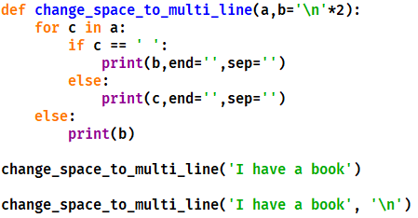
In class practice: what is the result for those code?

Slide 8

Using keyword with normal positional arguments
Can use the argument name as keyword.
When call function in this way, position will not matter. Python will look at the keywords, and give value respectively.

Slide 9
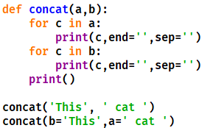
In class practice: what is the result for those code?

Slide 10
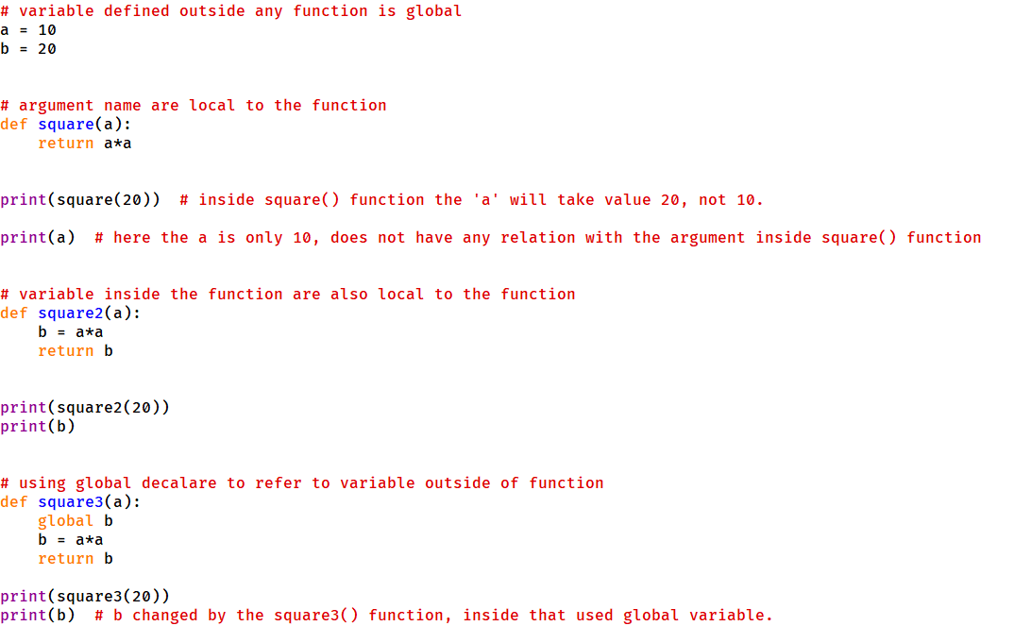
Scope of variable names
Argument name only valid in the function that defined it.
Variables created inside function only local to the function. Outside the function cannot see it.
If inside a function want to use/change a variable outside, need use global to declare it.

Slide 11
Python programming
unit 3a – function with variable arguments

Slide 12
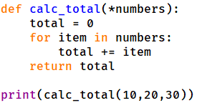
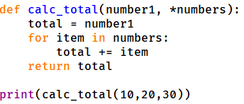
Variable number of arguments
When call the function, all values are packed together (tuple).
Inside function can take all items and use the value.
Variable number arguments must be the last in position.

Slide 13
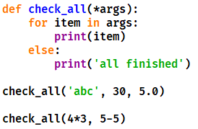
In class practice: what is the result for those code?

Slide 14
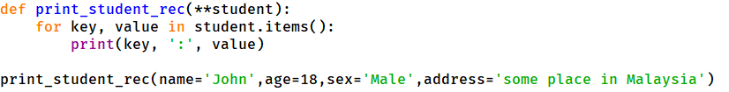
Variable number of named arguments
When call the function, all values are packed together like a dict. Keywords are packed as keys, values are packed as values
Inside function can take all items from the dict and use the key: value pairs.
Variable number arguments must be the last in position.

Slide 15
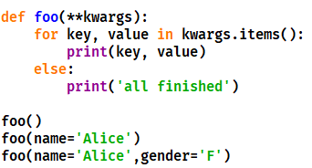
In class practice: what is the result for those code?

Slide 16
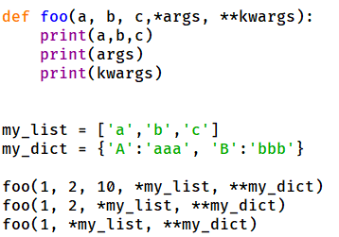
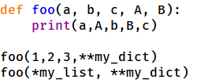
* And ** in function call
* can be used with list or other iterables, to give parameter to variable arguments to a function when doing a function call.
** can be used with dict, to give parameter to keyword variable arguments when doing a function call.

Slide 17
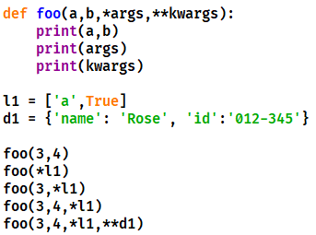
In class practice: what is the result for those code?

Slide 18
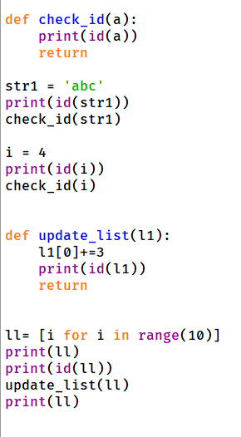
How value passed in function call
Pass by ref:
In python parameter passed like assignment, one more name associated with the data value which is the argument name inside the function.

Slide 19
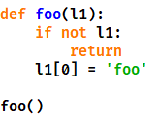
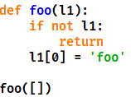
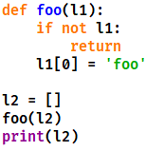
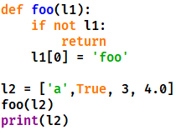
In class practice: what is the result for those code?

